Slide 1
UX/UI & PRODUCT DESIGN
ICPM – FUXI401 ASSIGNMENT

Slide 2
PROBLEM STATEMENT
Current Process Inefficiency:
The company's current process for requesting, approving, and reimbursing employees for workshops and online courses is inefficient and time-consuming.
This inefficiency discourages employees from pursuing professional development opportunities.
Lack of Employee Upskilling:
Due to the cumbersome process, many employees are discouraged from upskilling themselves through workshops or online courses.
This leads to a lack of up-to-date skills and knowledge within the organization.
Need for Streamlined System:
The company requires a streamlined and user-friendly system to manage its L&D programs and facilitate employee development.
The system should make it easier for employees to request, managers to approve, and the finance team to reimburse for workshops and courses.

Slide 3

USER PERSONA 1
Background
Gayatri Varma is a 45-year-old Sales Manager with 15 years of experience.
She has a successful track record in sales and consistently achieves her targets.
Varma is well-respected by her team and aims to enhance her leadership skills.
Pain points
Limited Managerial Support.
Struggle to find learning and development programs within her company.
Lack of opportunities to connect with experienced industry leaders.
Limited financial resources can limit her options for attending workshops, courses.
Balancing her regular job responsibilities and participating in programs can be a challenge.
Gayatri Varma
Motivations
Age
35
Gender
Female
Career Advancement
Continuous professional improvement and growth
L&D programs enable her to develop crucial leadership skills
Status
Married
Goals and Aspirations:
Location
Hyderabad
Develop Leadership Skills
Adapt to the Changing Sales Landscape
Opportunities to network and learn from experienced leaders in the industry

Slide 4
THINKS
SPEAKS
Empathy Map
want to continuously improve her skills and knowledge.
aspire to become an exceptional leader.
Learning new things gives her a sense of personal fulfilment.
believes in the success and growth of her sales team.
Advancing in her career is important to her.
To participate in workshops will help her enhance the leadership skills.
To incorporate the enhanced skills that has been learnt into the work.
Investing the time in L&D programs will have a tangible impact.
Balancing workload and L&D will be challenging.
DOES
FEELS
Actively seeks information about available L&D programs within the company.
Prioritizes her time to participate in relevant workshops, courses, or conferences.
Engages in networking events.
Seeks feedback and guidance from mentors.
Motivated and excited when she discovers relevant and impactful learning opportunities.
Overwhelmed when balancing her workload and participation in L&D programs.
Valued and empowered when her manager supports and encourages her professional development.
Satisfied when she can apply the skills learned in the programs to her role effectively.

Slide 5
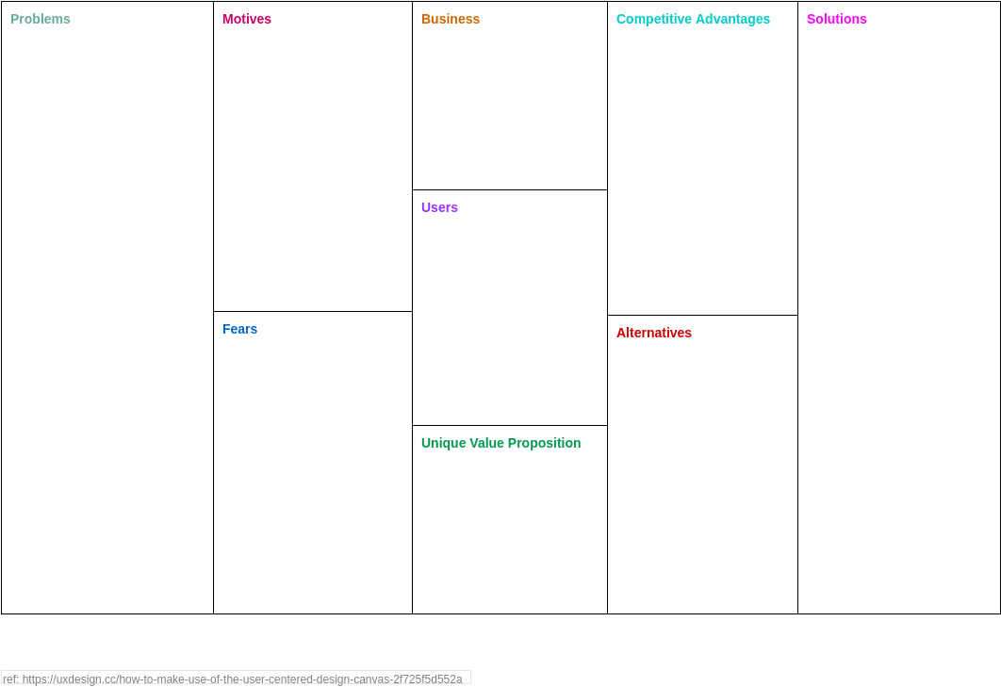

UCD CANVAS
Complex approval methods: The convoluted approval operations for workshop and course requests cause delays and deter the workforce from exploiting professional development opportunities.
Totally inadequate Reimbursement Process: The reimbursement process for authorized requests is inefficient, resulting in delays in refunding employees for their expenses.
Employee Discouragement: The lengthy process discourages employees from advancing their skills.
Outdated expertise and abilities: The organization lacks both knowledge and abilities.
Poor User Experience: The platforms' interfaces for users may be confusing and unintuitive.
Personalization: The platform may lack elements that allow for customization.
Progress Tracking and Evaluation: The platform may be lacking in comprehensive tracking and evaluation mechanisms.
Inconsistent Learning: Due to a heavy workload, users may encounter deviations in their learning experience.
L&D Program Management System: A system that makes it easier to successfully manage learning and development initiatives.
Promote Employee Upskilling: Acknowledge the significance of employee professional growth and upskilling.
Enhance the ineffective structure of the current process for employee requests, approvals, and reimbursements for workshops and online courses.
Developing an interesting and user-friendly platform.
Web platform aims to revolutionize the way mid-sized companies manage their learning and development programs. By providing a user-friendly online hub, empowering employees to upskill and advance their professional capabilities conveniently and efficiently.
Comprehensive Course Catalog: featuring a wide range of high-quality courses and workshops, covering diverse topics and areas of professional development.
Personalization and Recommendation Engine.
Efficient Approval and Reimbursement Process
Robust Progress Tracking and Reporting.
Integration with external resources.
Simplified Approval Processes: To quicken the overall permitting process, create a streamlined workflow with predefined approval paths and automated alerts.
Efficient Reimbursement Process: Provide an automated system that makes it simple for employees to report their expenditures, while allowing the finance team to quickly verify and handle reimbursements.
Incentives and Recognition: Provide incentives or awards, such as certificates, badges, or prospects for career promotion, to employees who actively engage in upskilling programs.
Integration with External Learning Resources: Integration with online course providers or industry-specific platforms.
Personalization: Develop algorithms or recommendation systems.
Progress Tracking and Assessment: Implement robust tracking mechanisms to monitor user progress, completion rates, and learning outcomes.
Remainders: send out reminder emails to maintain consistency.
Employees: Individuals from various job roles.
Managers and Team Leads.
(HR) Professionals: Track employee participation and progress.
(L&D) Team: Responsible for designing, developing, and managing the learning programs.
Finance Team: Approving employee requests, handling reimbursements
Employees may worry that the new platform would be complicated and challenging to use, necessitating a steep learning curve.
Employees may worry about delays in the approval of their requests for workshops or courses.
Employees may worry about problems with compensation for authorized seminars or courses.
Workers may worry about possible platform security breaches or improper management of their personal and financial data.
Employees can request workshops or courses via email, ask managers for permission, and finance team to obtain reimbursement.
External Learning Platforms: Team members can autonomously pursue their professional development by searching on google or other external learning platforms.
Personal Funding: Some professionals may choose to finance for all of their professional development expenses from their pocket, with no request for reimbursement from the employer.
A web platform empowers employees within the company to upskill and advance their professional capabilities through a diverse learning programs. With streamlined processes, personalised experiences, and high-quality content, it fosters a culture of continuous learning and development.

Slide 6

Design Challenge
Design Model
Potential Solutions
Card Sorting
User Flow

Slide 7
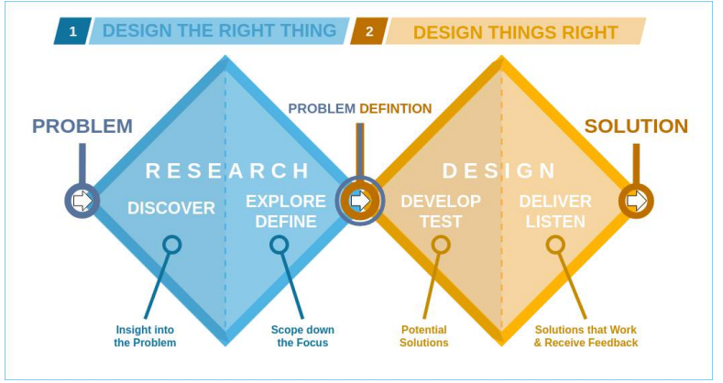
Design Model

Slide 8
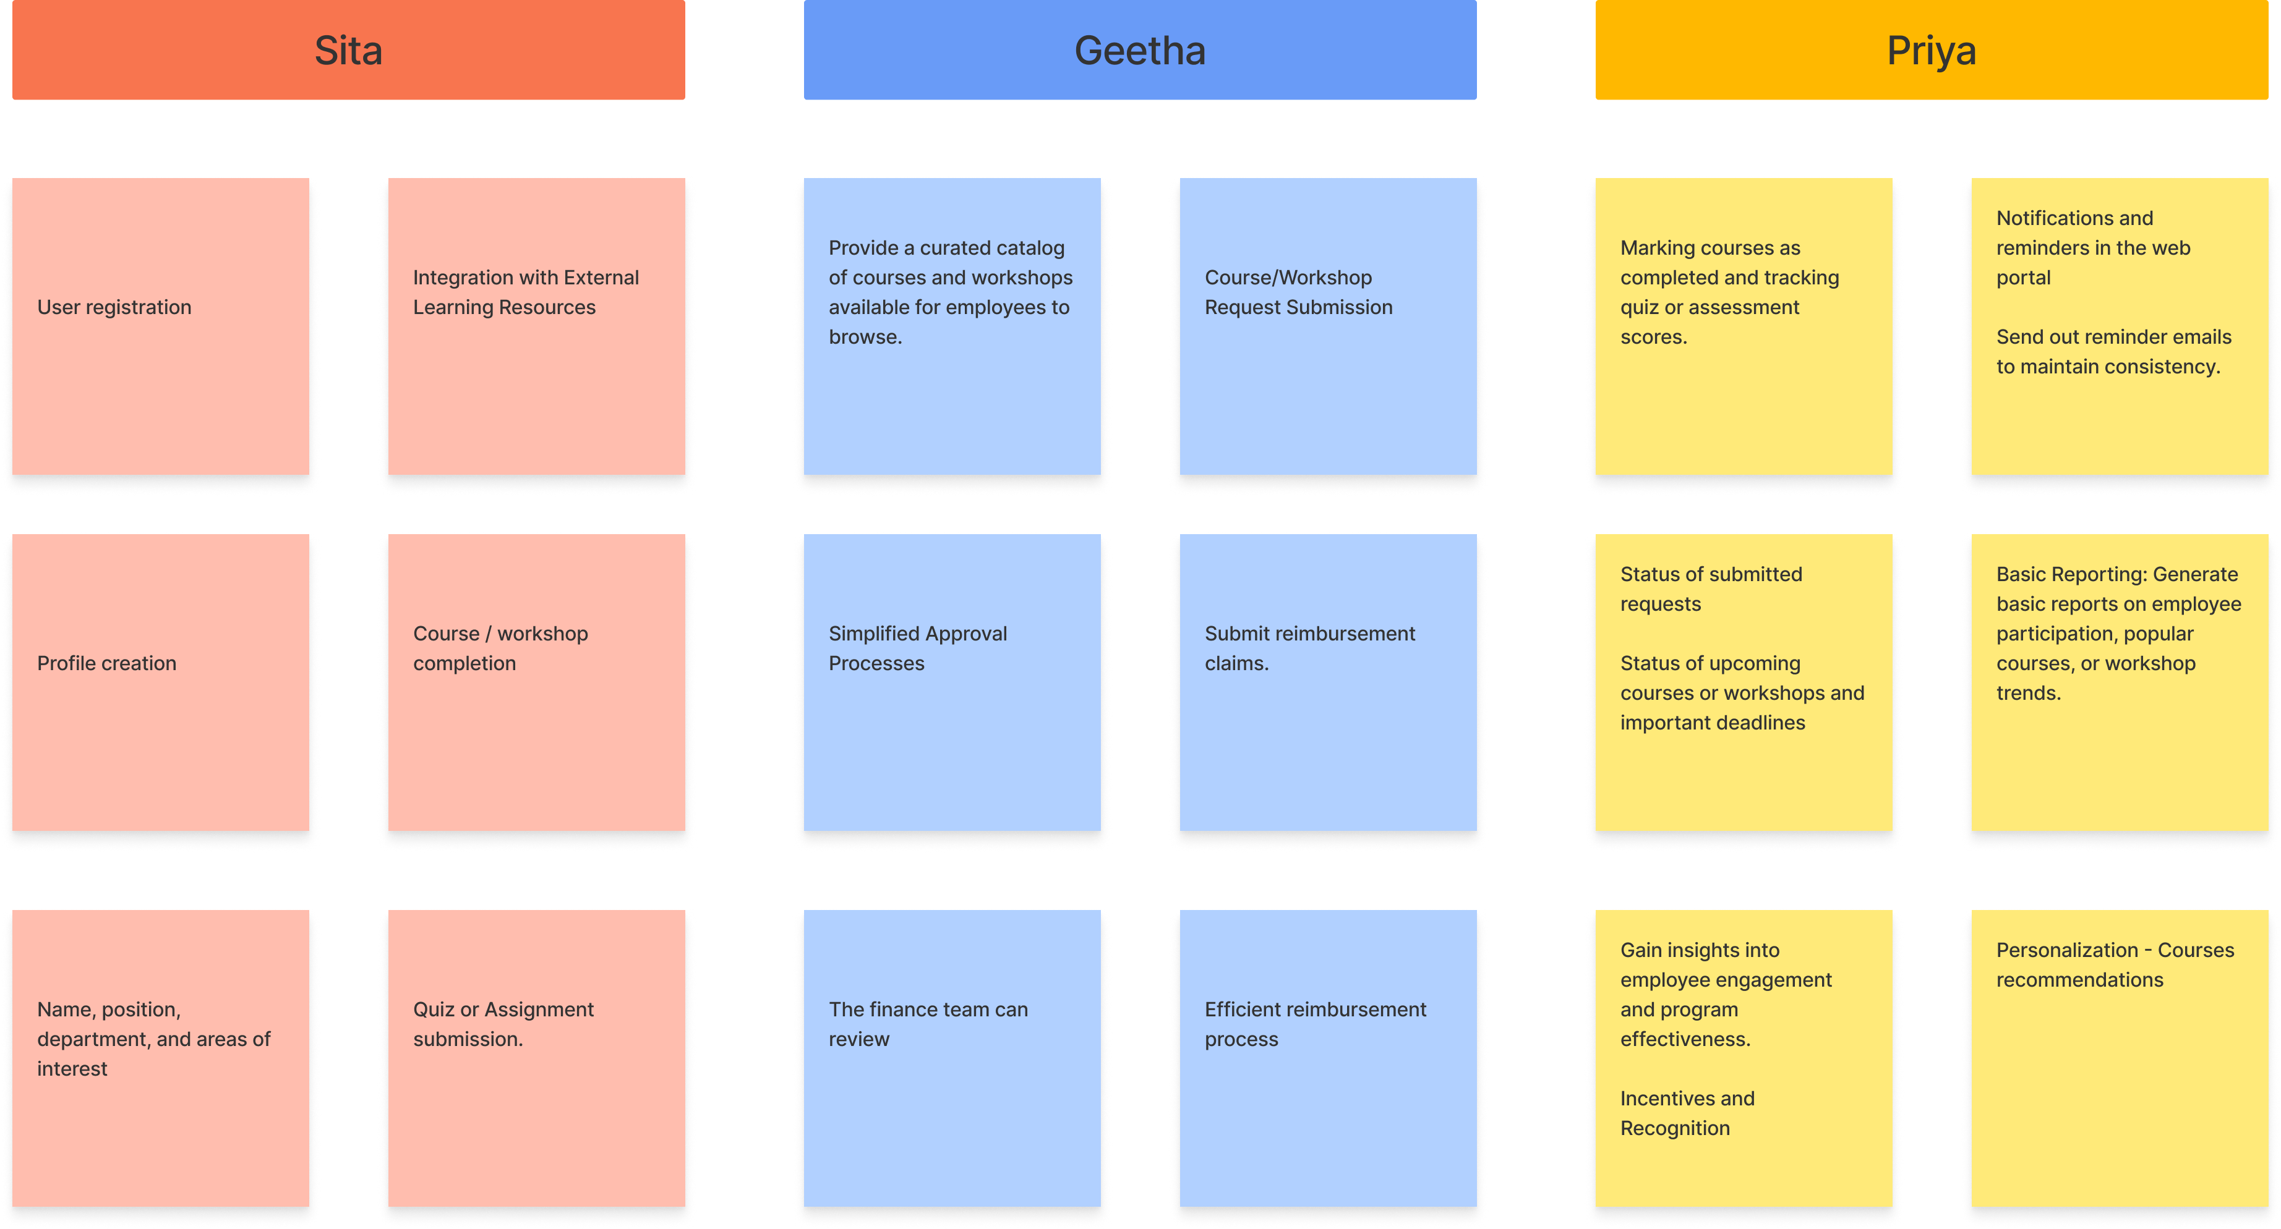
Potential Solutions

Slide 9
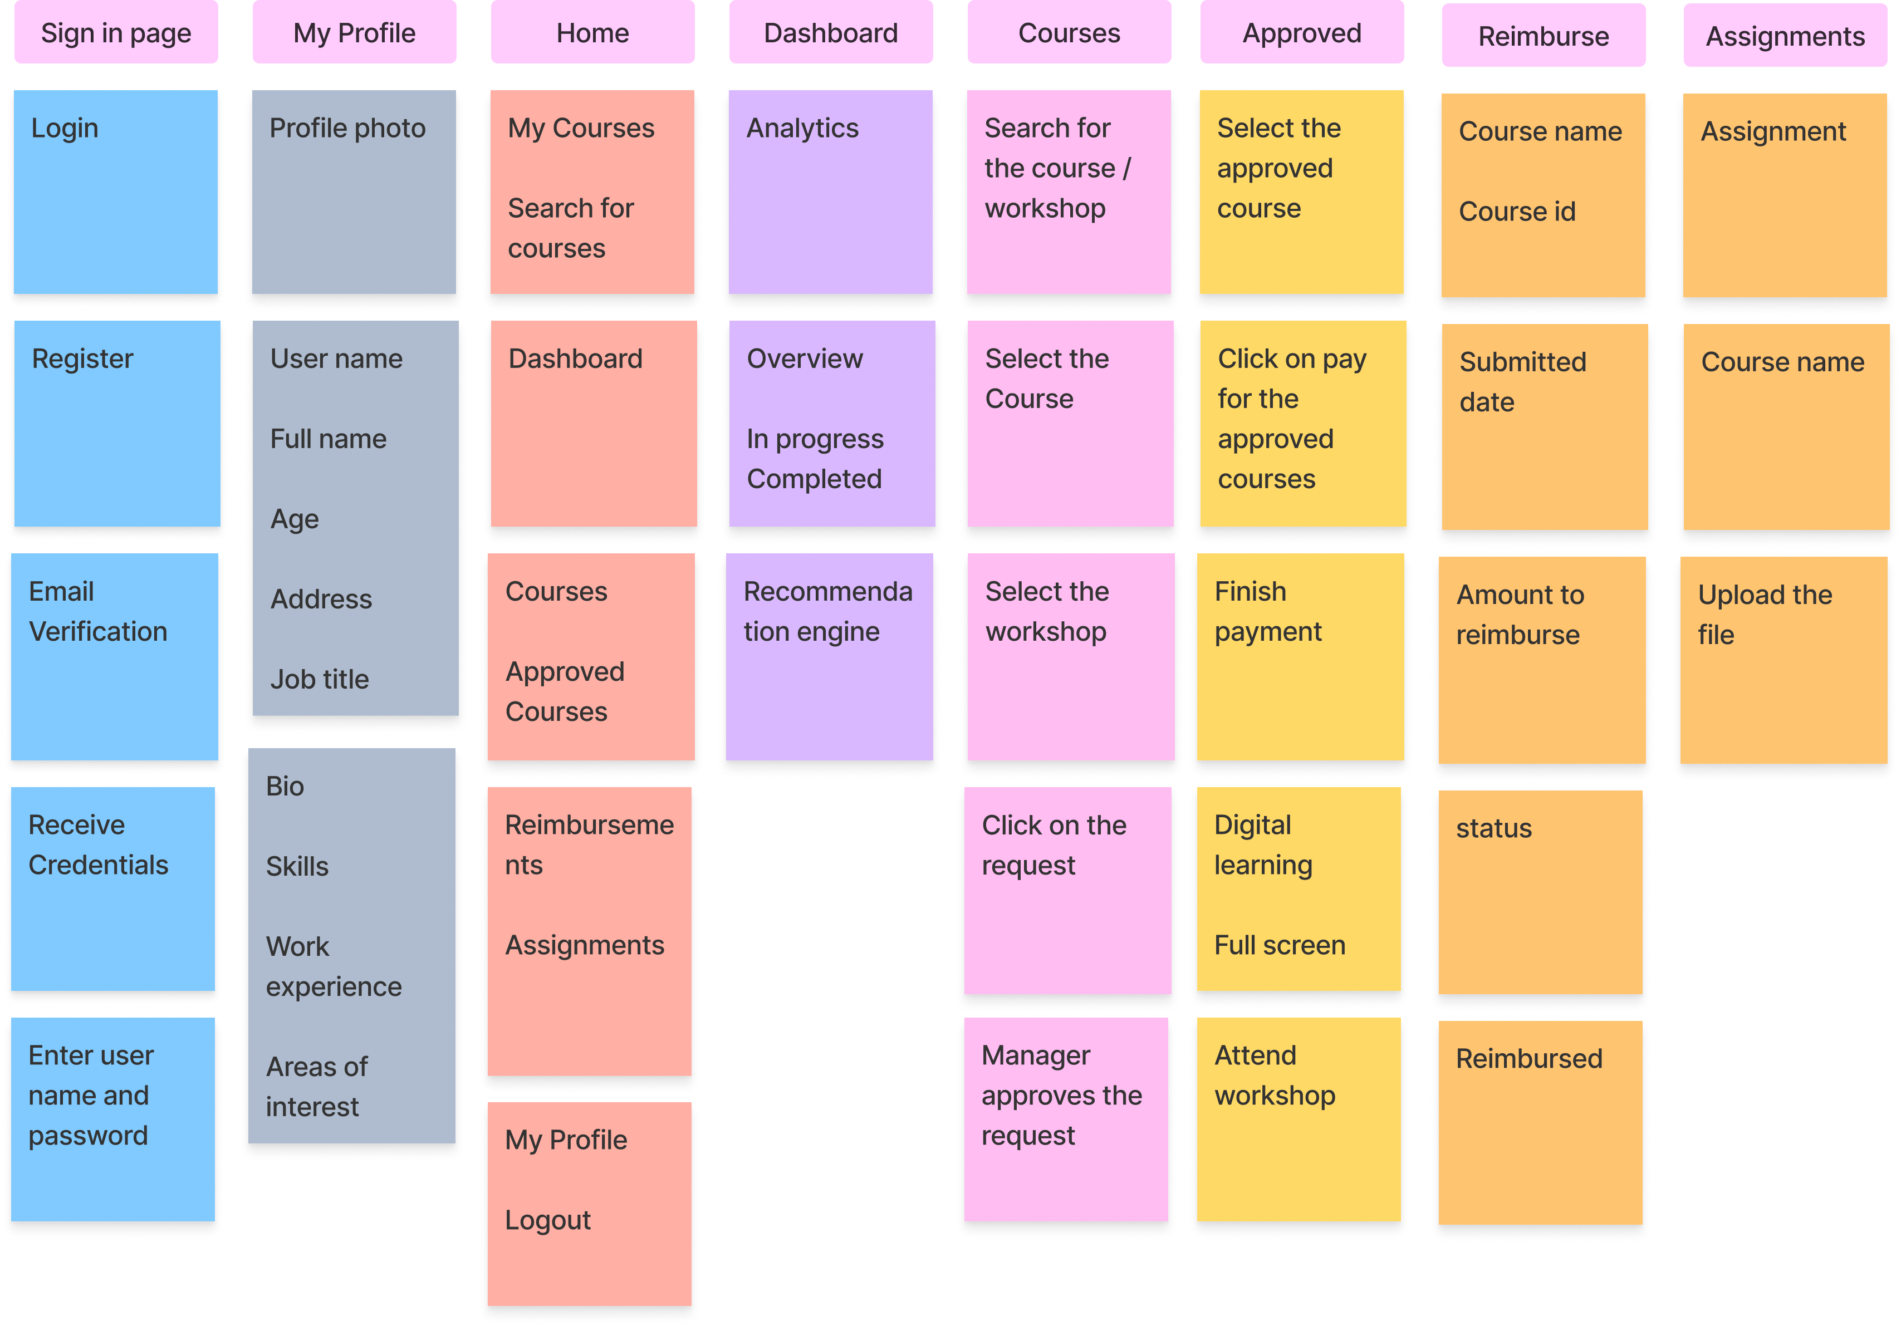
Card Sorting

Slide 10
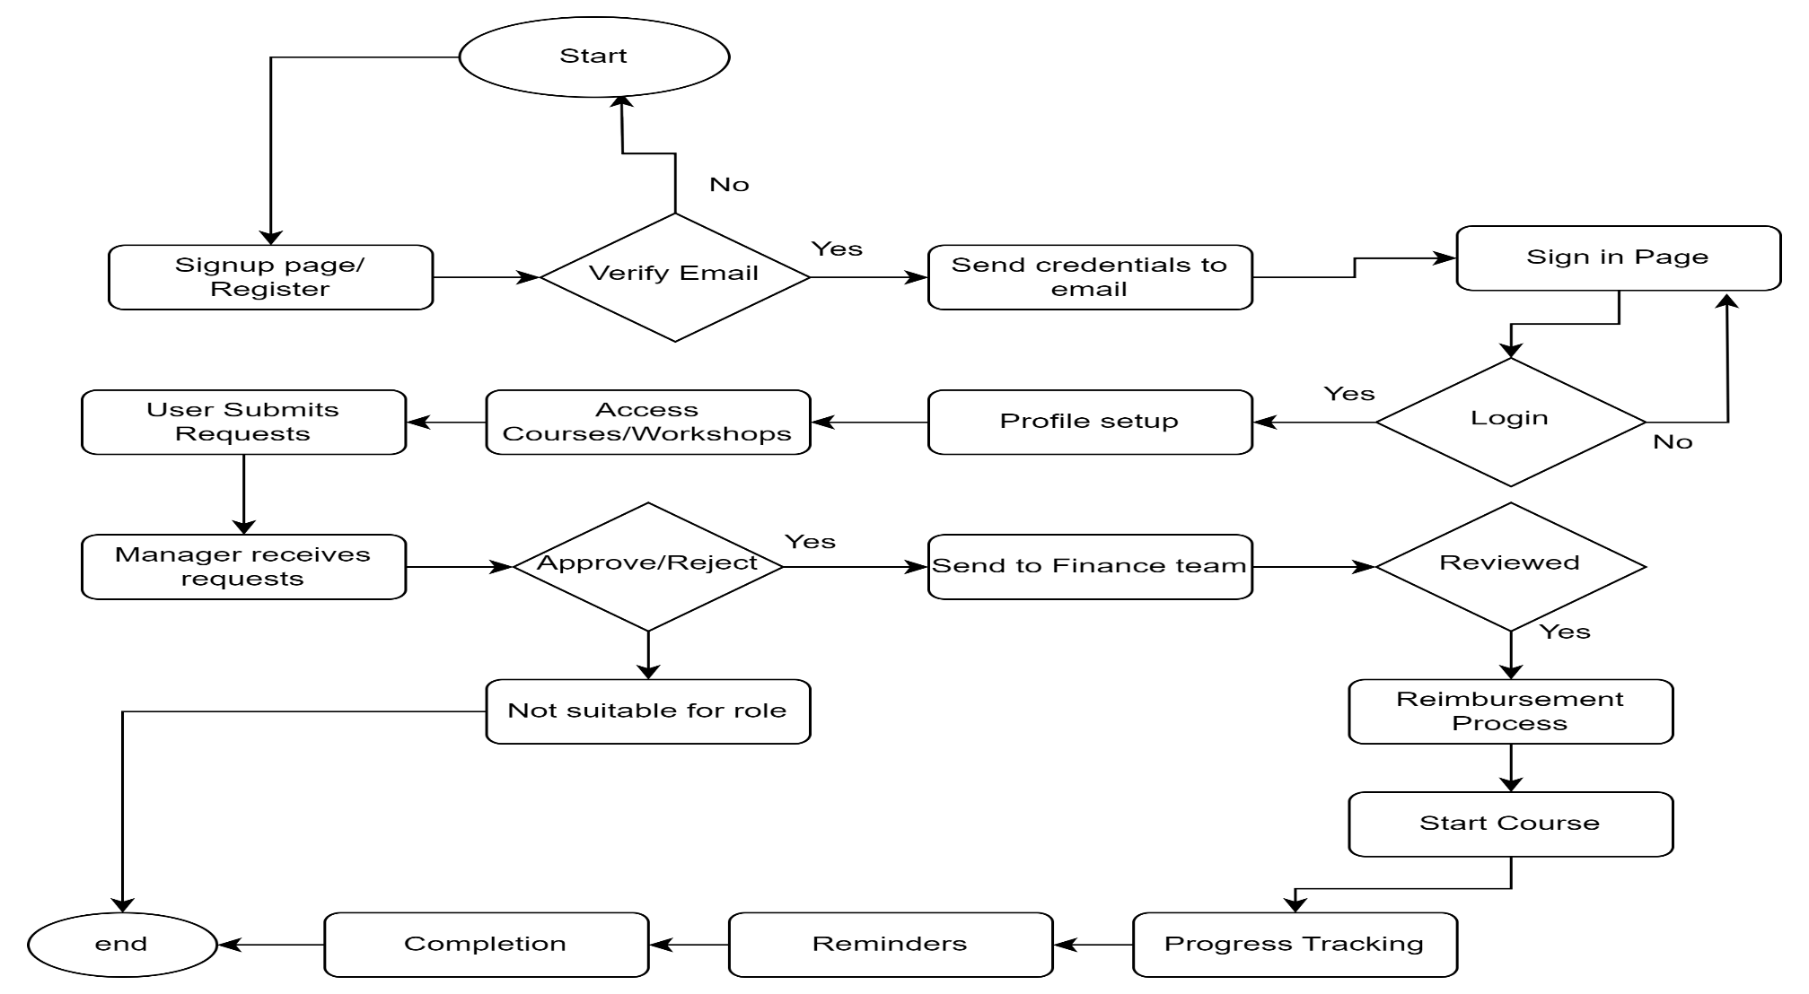
User Flow

Slide 11

Wire Framing

Slide 12
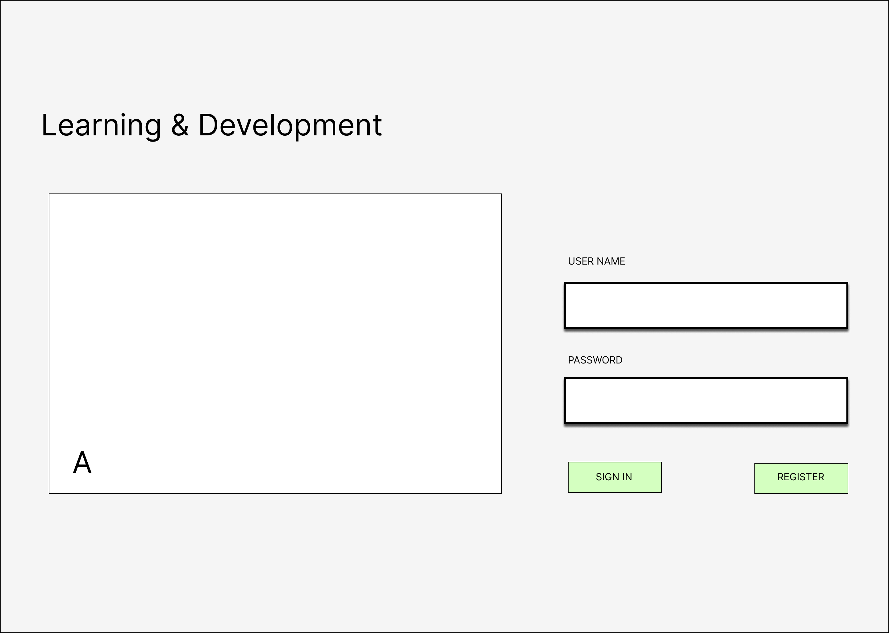
Wire frame – Sign in / Register
Sign in / Register page
Email Verification
Input fields - Use credentials
Buttons – Sign in, Register
A. Company name & Logo

Slide 13
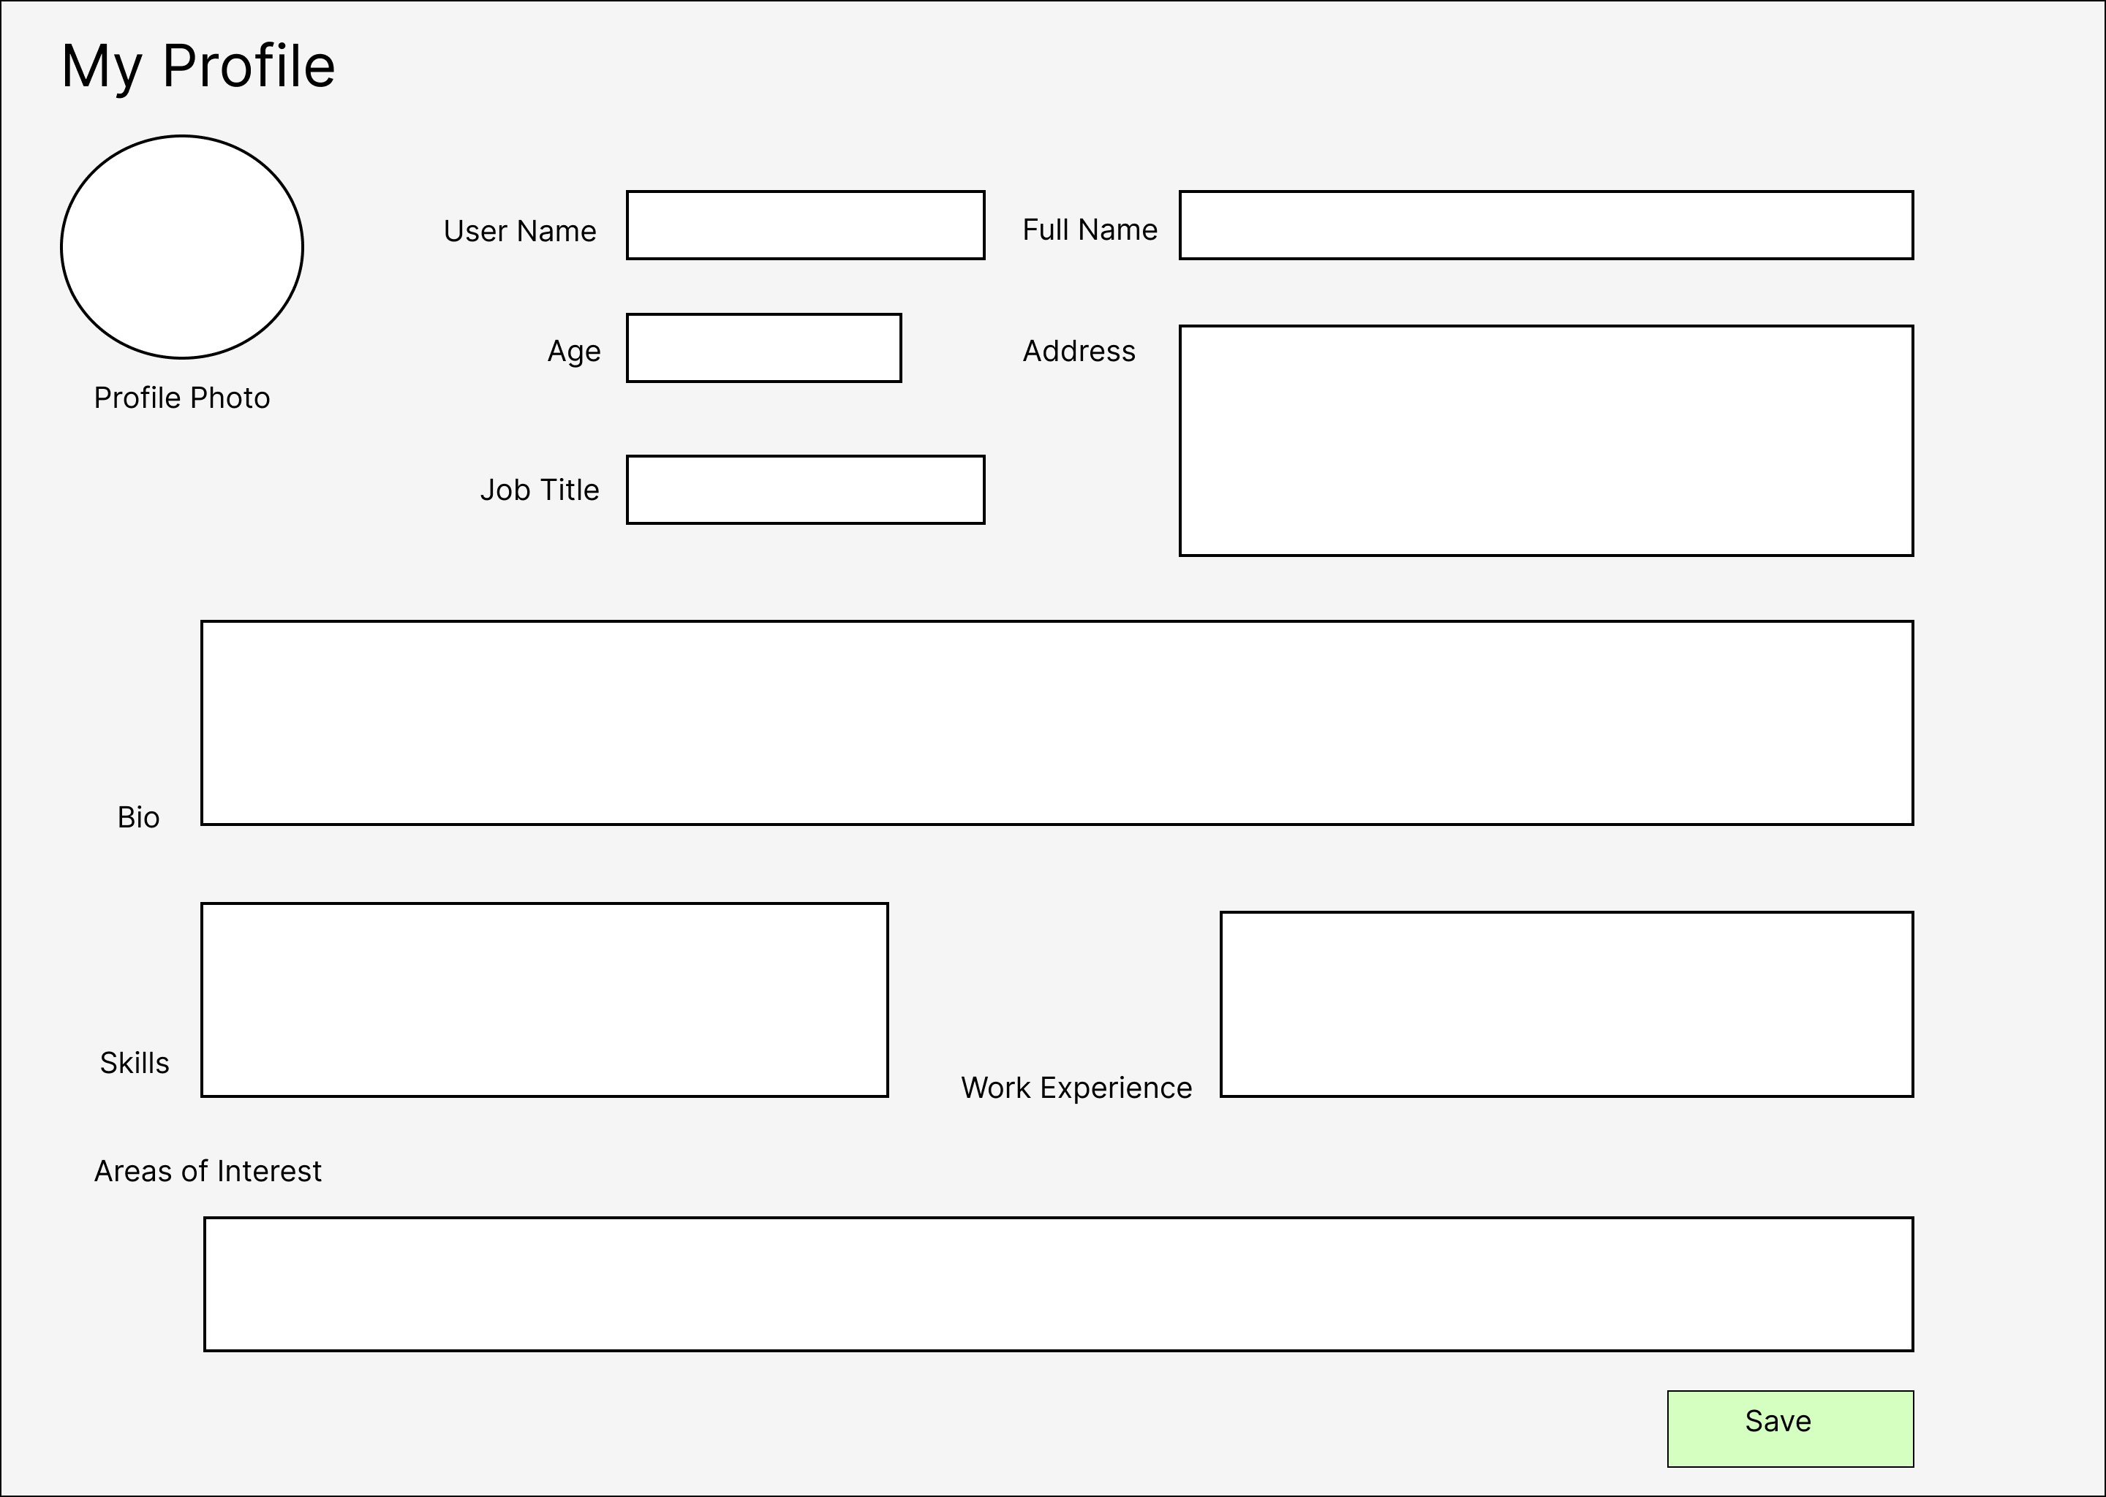
Wireframe – My Profile
Navigate to my profile after logging in successfully.
Upload Profile Photo
Input fields
User name
Full name
Age
Job title
Address
Bio
Skills
Work experience
Areas of interest
4. Button - Save

Slide 14
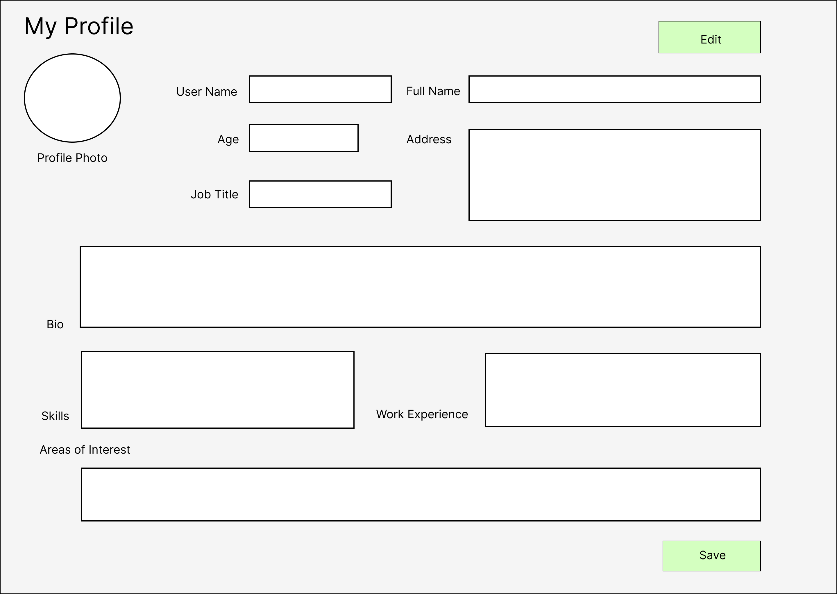
Wireframe – My Profile
Navigate to my profile by clicking on it.
Edit – Click on edit to edit the required fields
Edit Input fields
User name
Full name
Age
Job title
Address
Bio
Skills
Work experience
Areas of interest
Button - Save

Slide 15
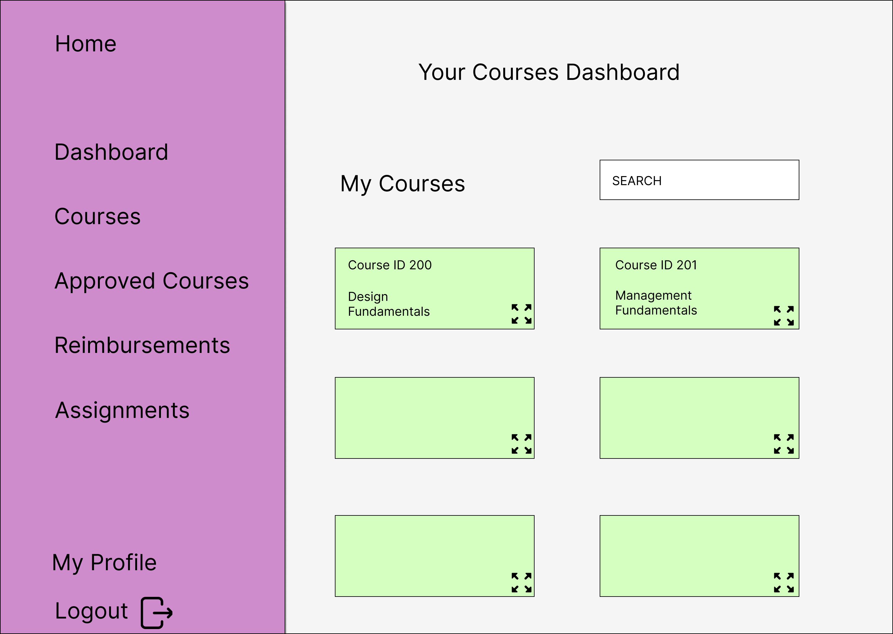
Wire Frame – Home Page
Home - Default landing page
My Courses
Search for the course
Click on the course
Continue learning

Slide 16
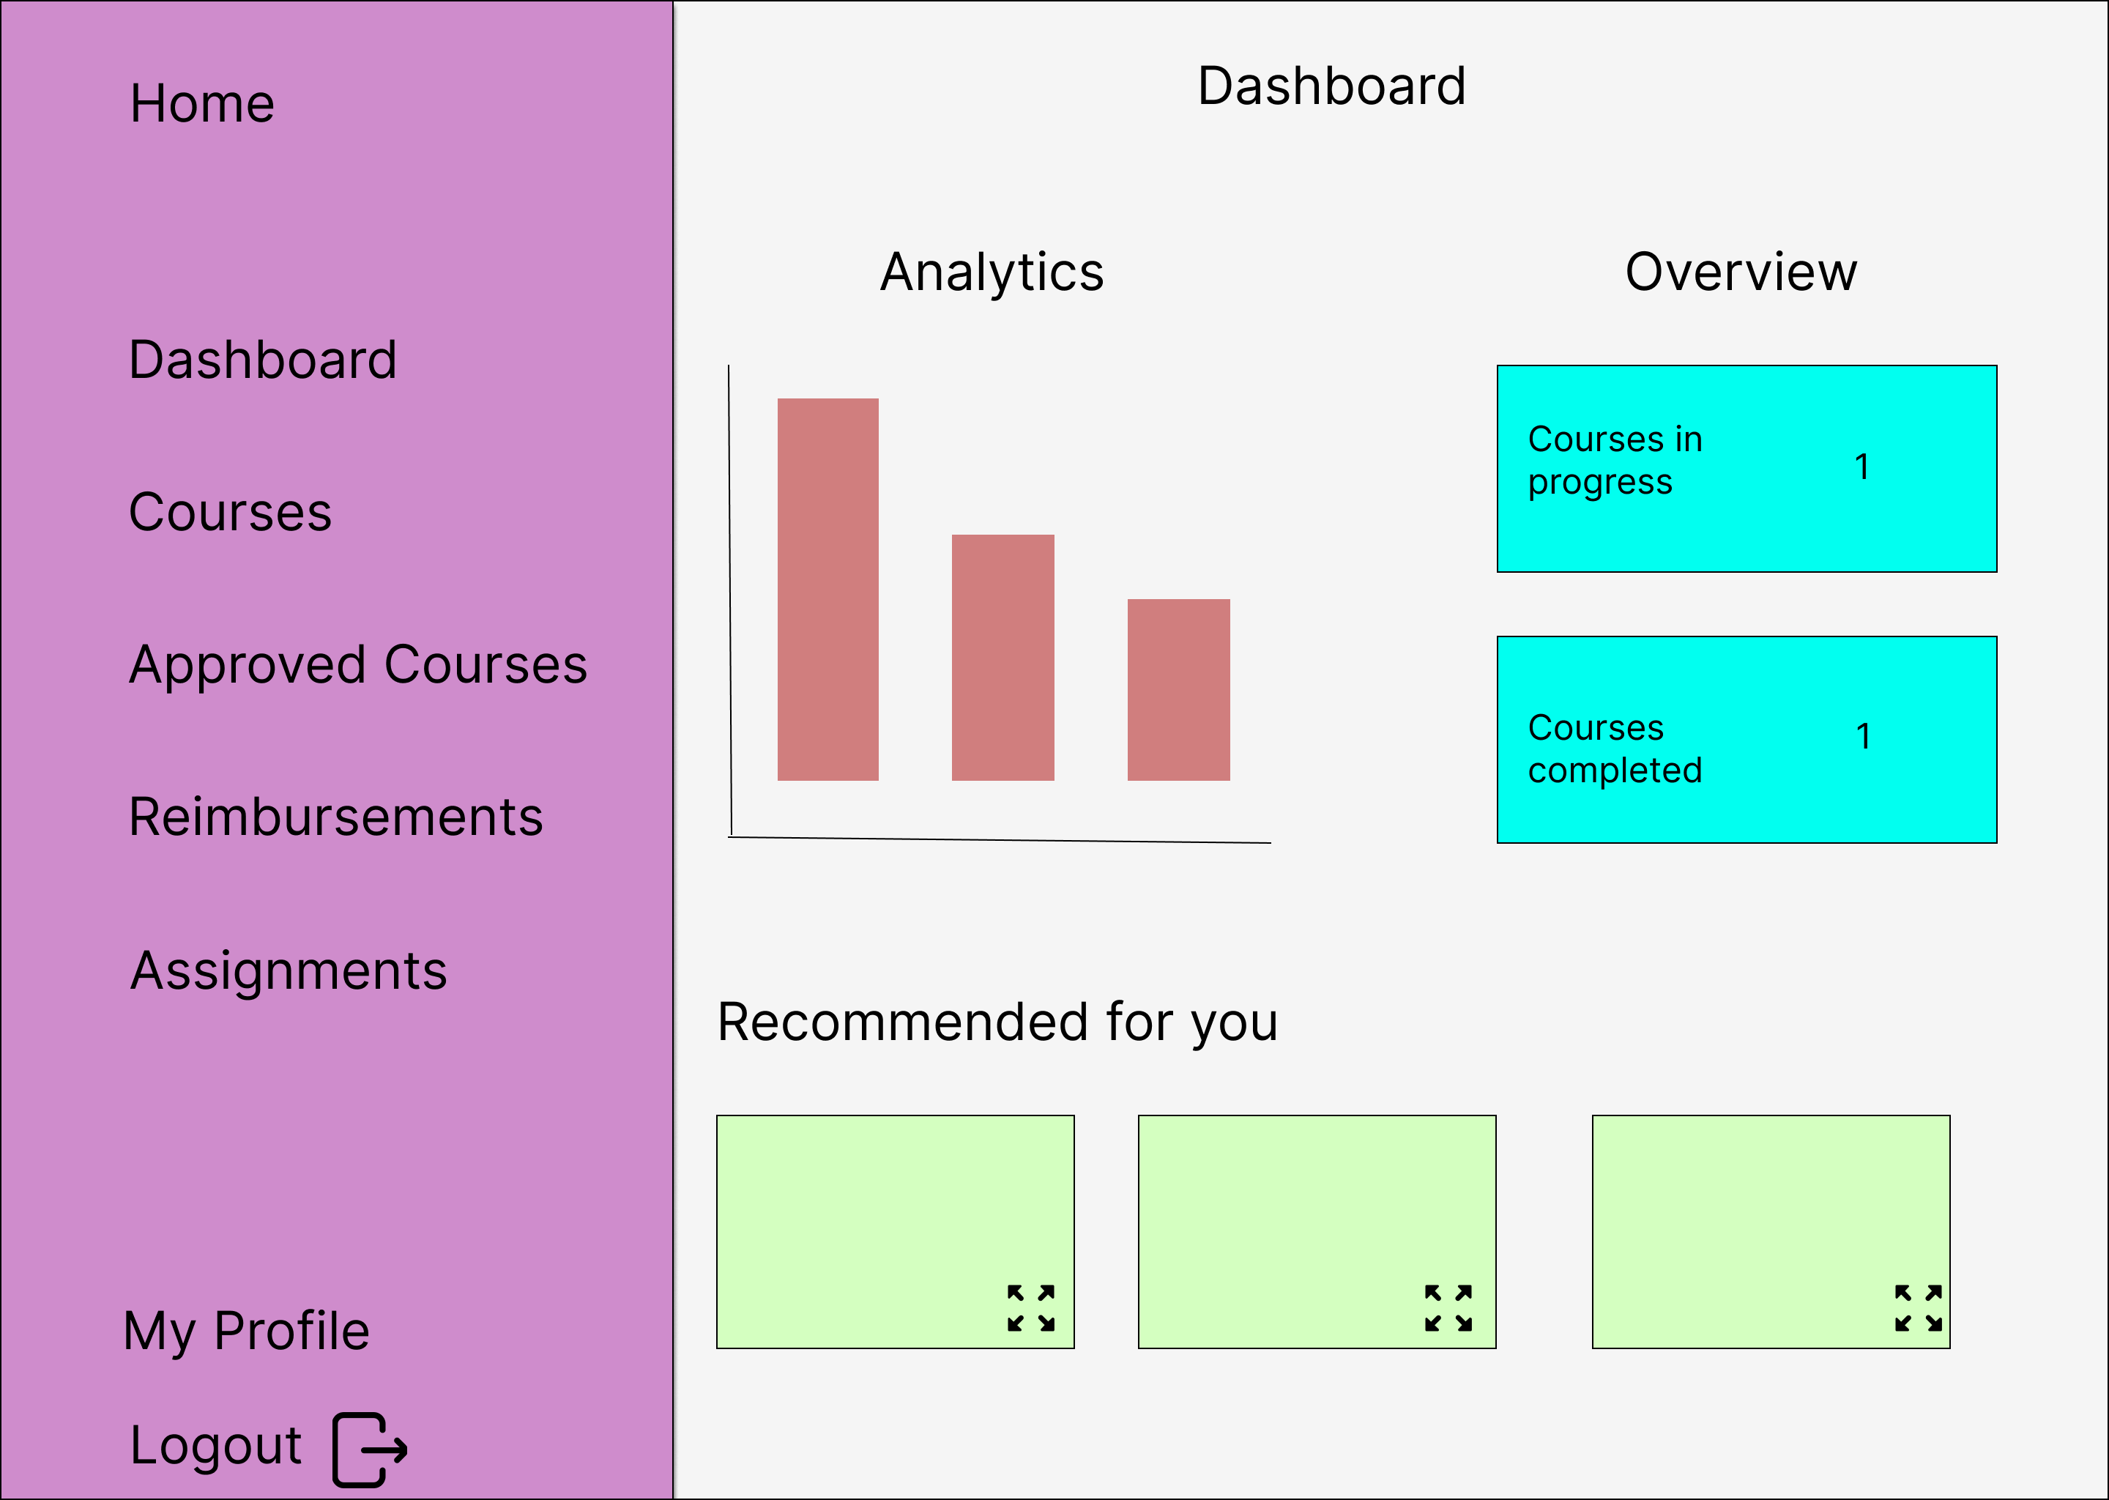
Wire Frame - Dashboard
Dashboard - Click and navigate to the dashboard page
View Analytics
View overview of courses
Course Recommendations

Slide 17
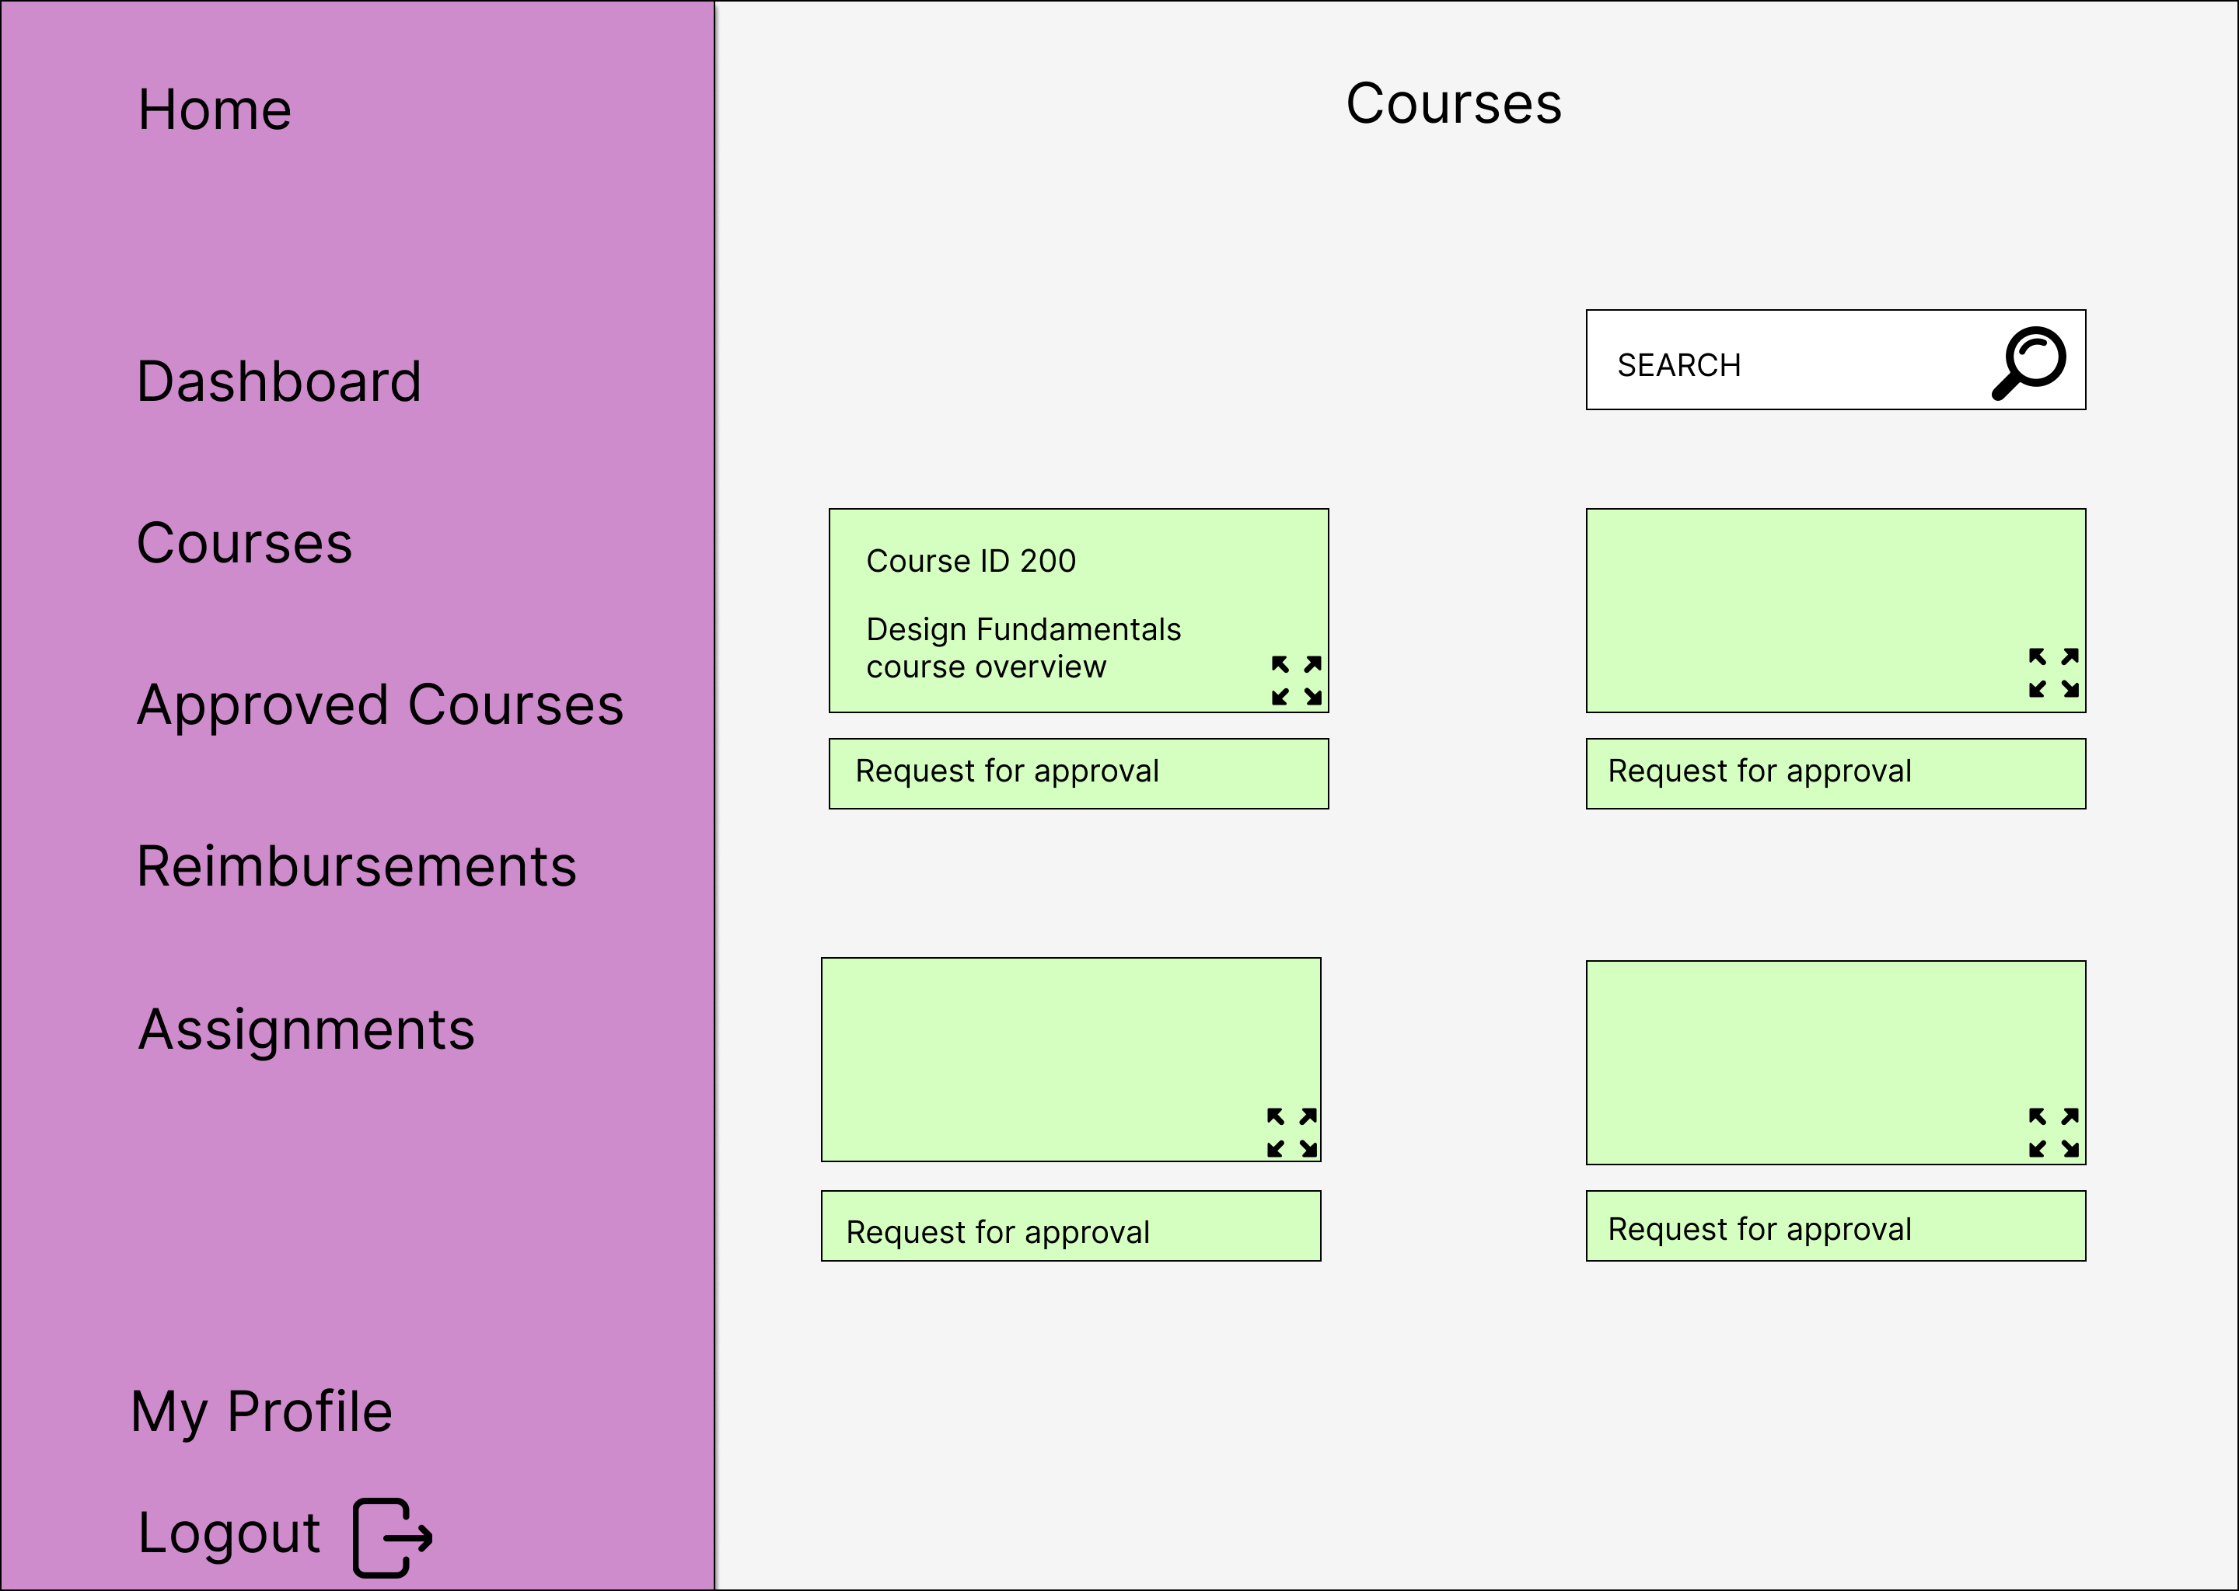
Wire Frame - Courses
Courses - Click and navigate to the courses page
Search Courses
Select courses
Watch the course overview
Request manager for course approval

Slide 18
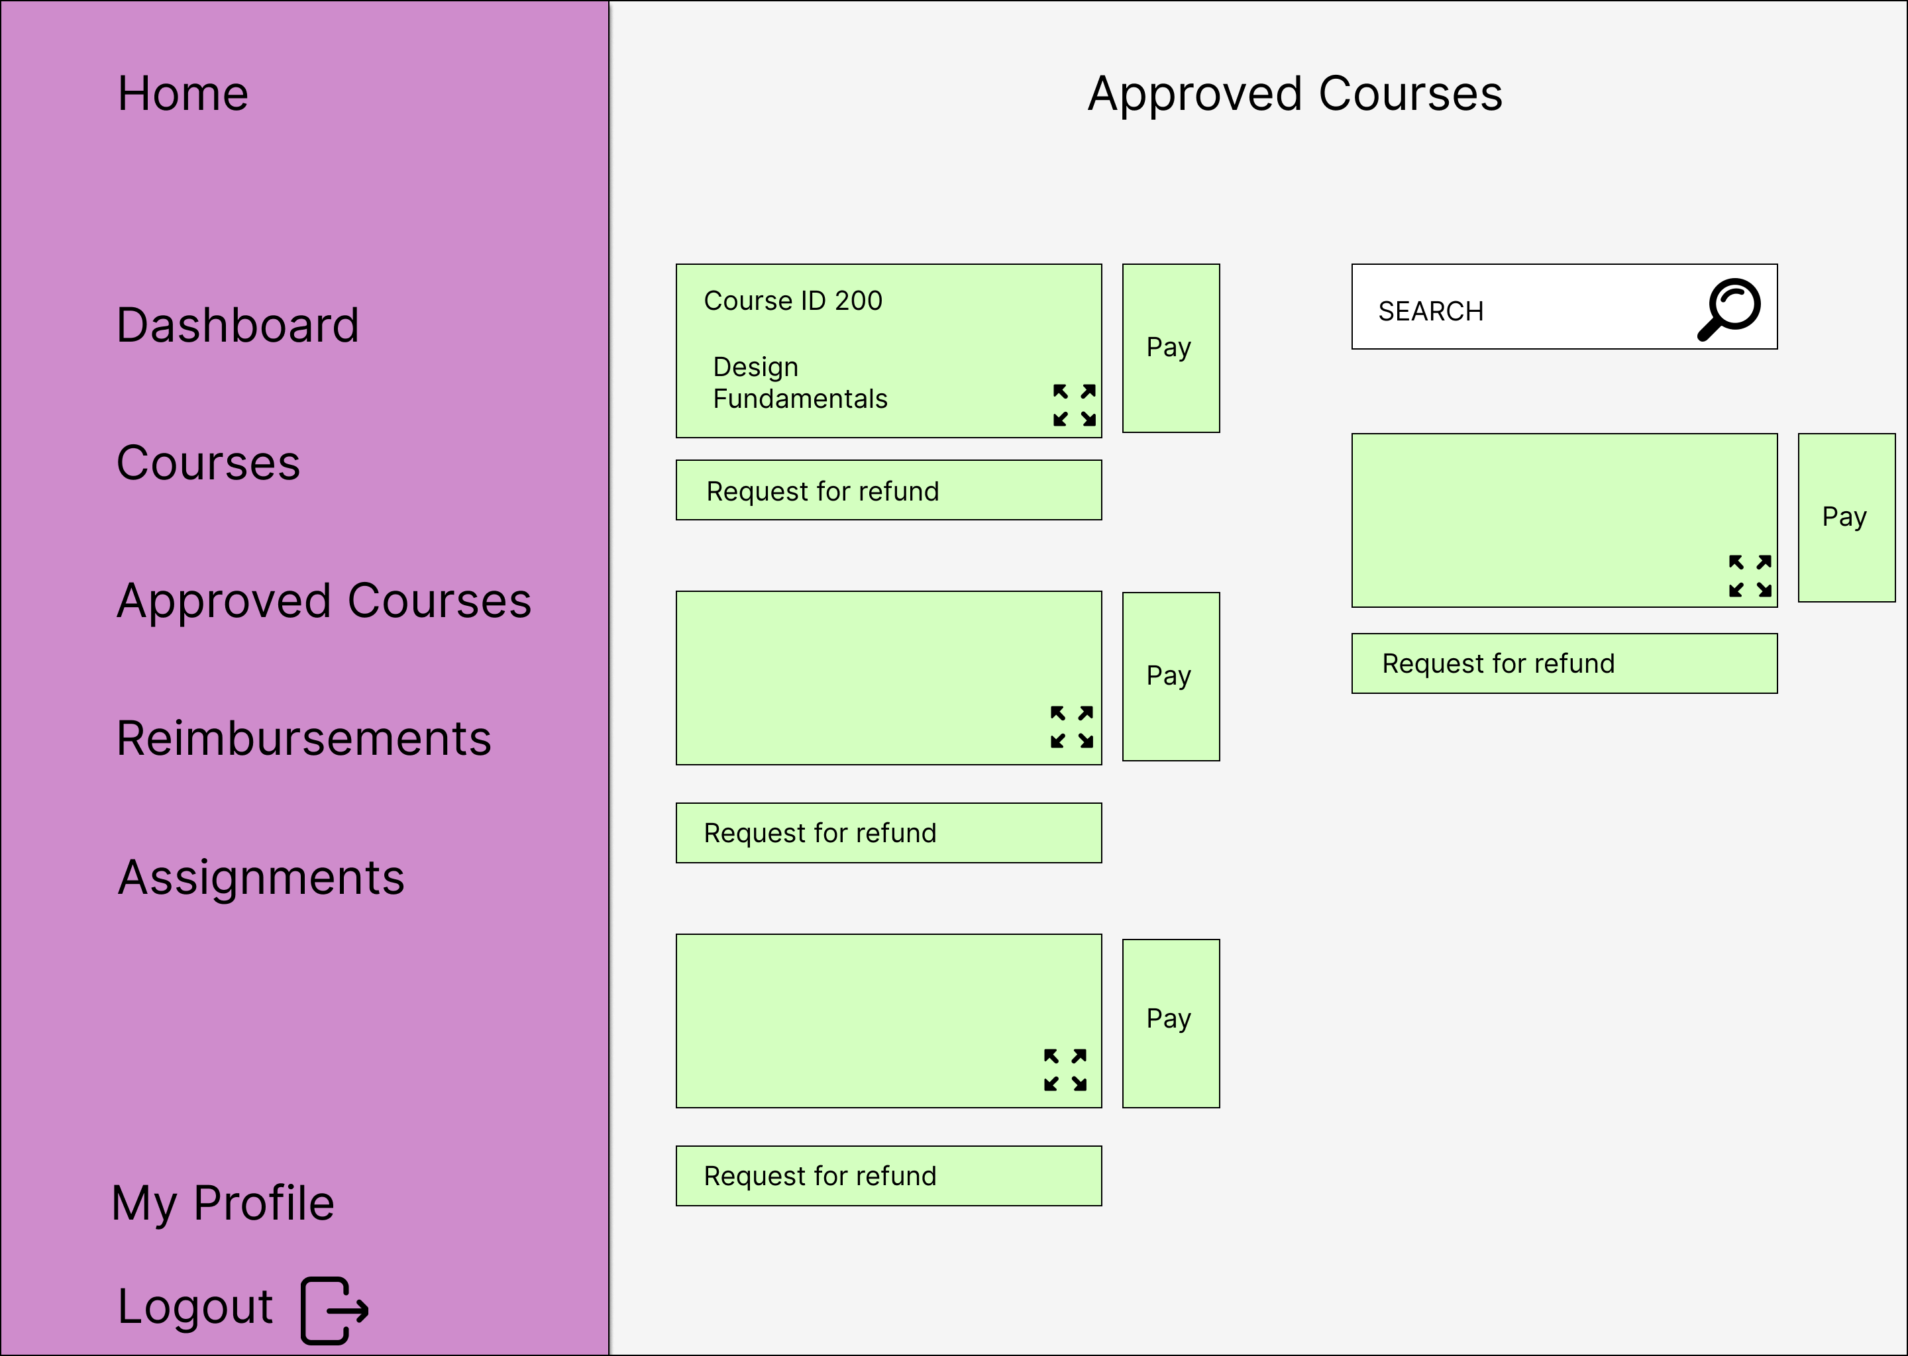
Wire Frame – Approved Courses
Approved Courses - Click and navigate to the approved courses page
Search Course
Select course
Start the course
Pay for the approved course
Request Finance team for refund

Slide 19
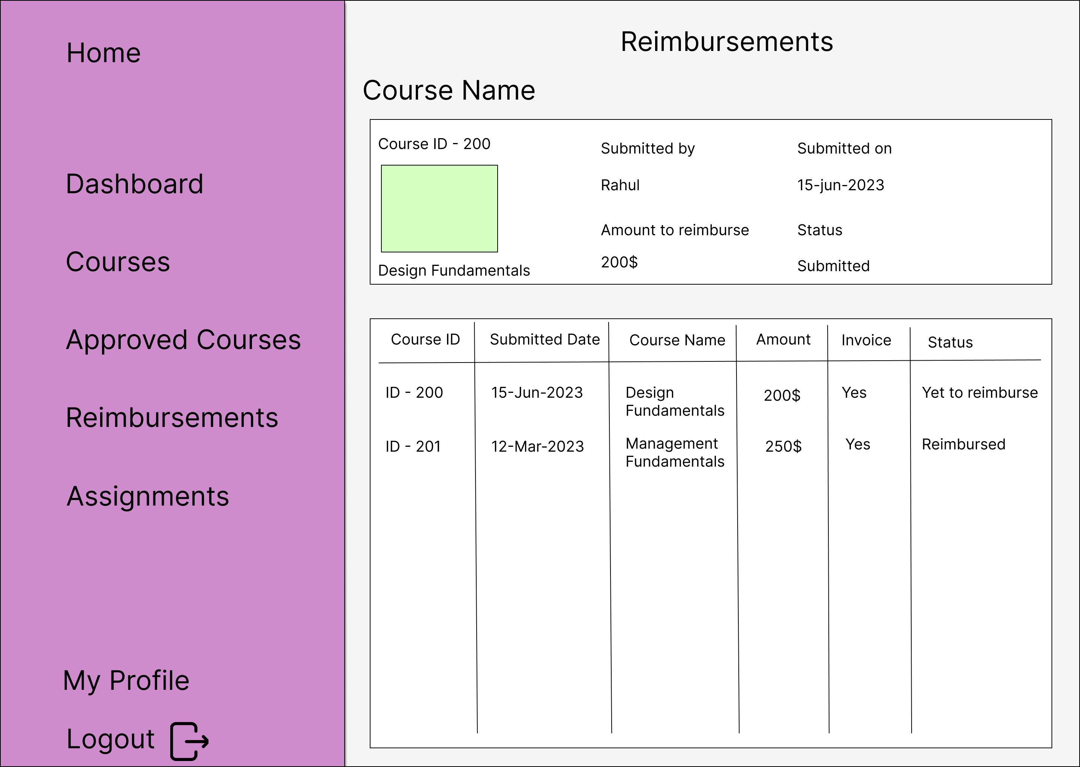
Wire Frame - Reimbursements
Reimbursements - Click and navigate to the Reimbursements page
View the refund raises course and its status.
View the history of the refund raised courses and with their status.

Slide 20
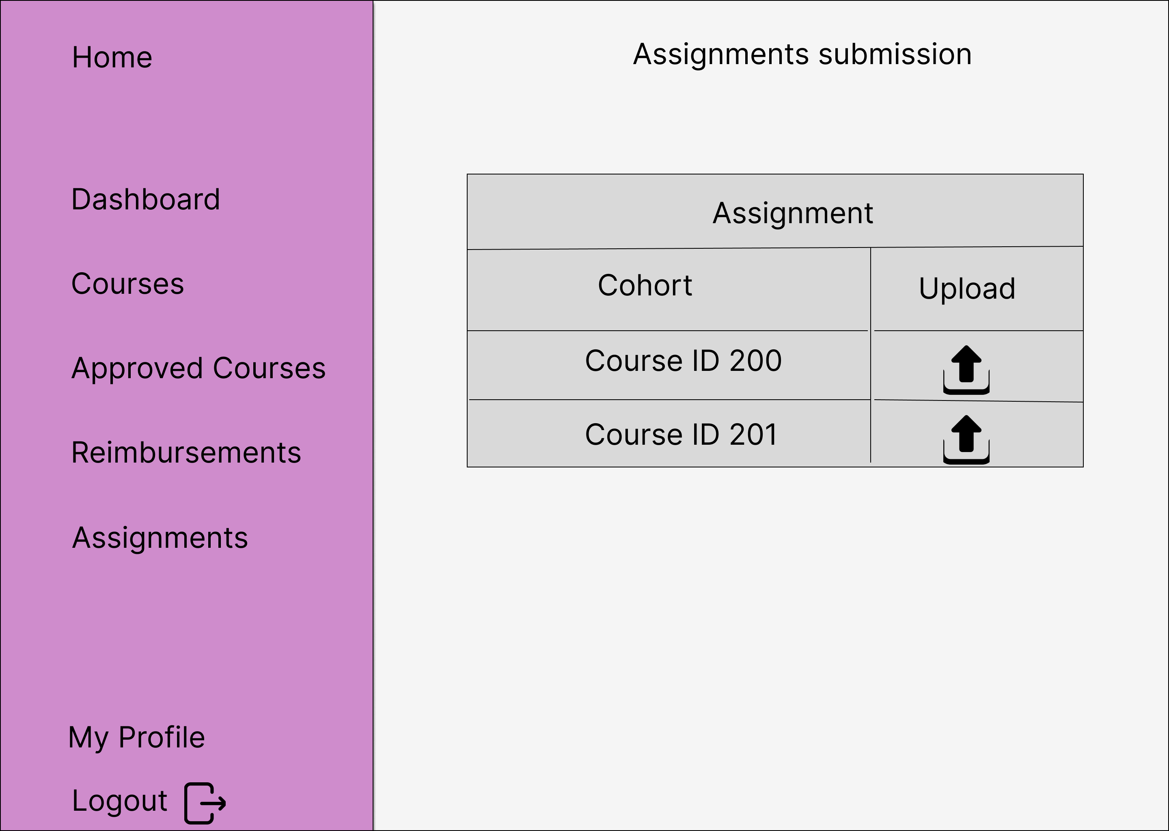
Wire Frame – Assignments submission
Assignments Submission - Click and navigate to the assignments page
View the course ID
Click on the upload icon
Submit assignment for the necessary course ID

Slide 21
Prototype
Link:
https://www.figma.com/proto/OUmJu8aspsmfcuxaAI9Ck3/Assignment-ICPM---FUXI-401?type=design&node-id=10-22&scaling=contain&page-id=0%3A1&starting-point-node-id=10%3A22

